Slide 1
Lecture 15:
Dynamic Programming
Keren Zhu
kerenzhu@cse.cuhk.edu.hk

Slide 2
Dynamic programming
Dynamic programming follows the idea of divide-and-conquer ideology: but subproblems overlap
The basic steps to form a DP algorithm are
  1. Characterize the structure of an optimal solution
  2. Recursively define the value of an optimal solution
  3. Compute the value of an optimal solution, typically in a bottom-up fashion
  4. Construct an optimal solution from computed information
Step 2 in most time is the most difficult step, and your homework will ask you to construct the dynamic programming recurrence of problems

Slide 3
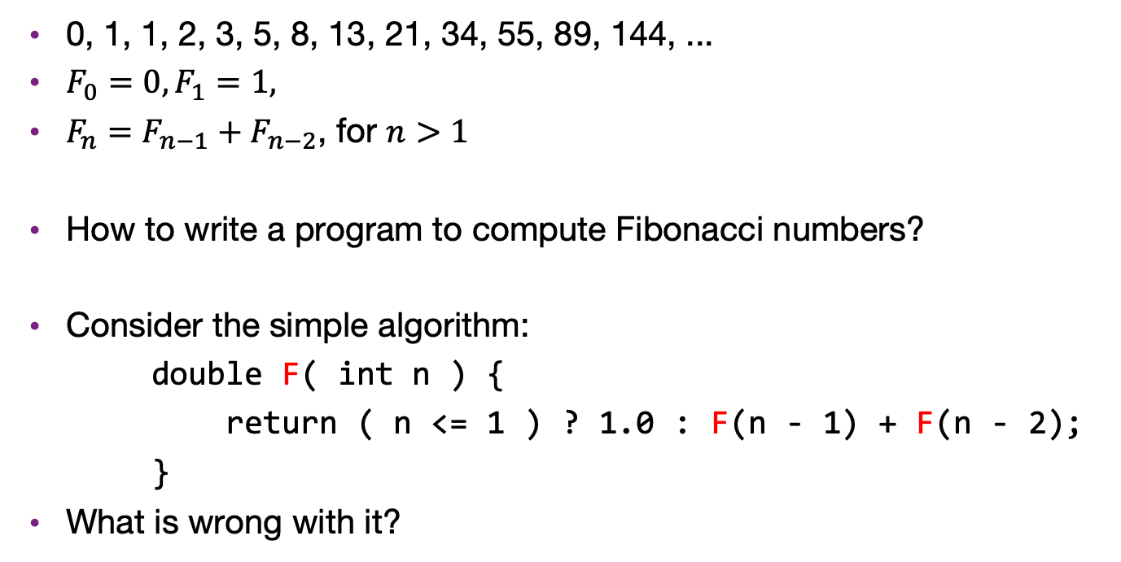
Fibonacci sequence
0, 1, 1, 2, 3, 5, 8, 13, 21, 34, 55, 89, 144, ...
$F_{0}=0, F_{1}=1,$
$F_{n}=F_{n−1}+F_{n−2}$, for $n>1$
How to write a program to compute Fibonacci numbers?
Consider the simple algorithm:
    double F( int n ) {
    return ( n <= 1 ) ? 1.0 : F(n - 1) + F(n - 2);
    }
What is wrong with it?

Slide 4
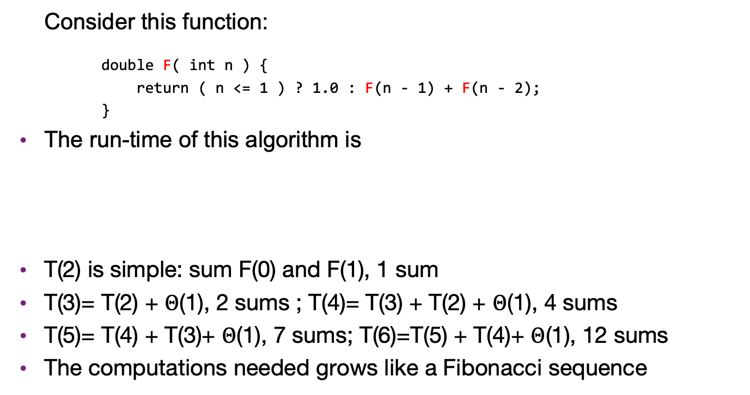
Naive Fibonacci number algorithm
Consider this function:
    double F( int n ) {
    return ( n <= 1 ) ? 1.0 : F(n - 1) + F(n - 2);
    }
The run-time of this algorithm is
T(2) is simple: sum F(0) and F(1), 1 sum
T(3)= T(2) + $Θ$(1), 2 sums ; T(4)= T(3) + T(2) + $Θ$(1), 4 sums
T(5)= T(4) + T(3)+ $Θ$(1), 7 sums; T(6)=T(5) + T(4)+ $Θ$(1), 12 sums
The computations needed grows like a Fibonacci sequence

Slide 5
Fibonacci numbers
To demonstrate, consider:
#include <iostream>
#include <ctime>
using namespace std;
int main() {
cout.precision( 16 ); // print 16 decimal digits of precision for doubles
// 53/lg(10) = 15.95458977...
for ( int i = 33; i < 100; ++i ) {
cout << "F(" << i << ") = "
<< F(i) << '\t' << time(0) << endl;
}
return 0;
}
double F( int n ) {
return ( n <= 1 ) ? 1.0 : F(n - 1) + F(n - 2);
}

Slide 6
Fibonacci numbers
The output:
    F(33) = 5702887 1206474355
    F(34) = 9227465 1206474355 F(33), F(34), and F(35) in 1 s
    F(35) = 14930352 1206474355
    F(36) = 24157817 1206474356
    F(37) = 39088169 1206474358
    F(38) = 63245986 1206474360
    F(39) = 102334155 1206474363
    F(40) = 165580141 1206474368
    F(41) = 267914296 1206474376
    F(42) = 433494437 1206474389
    F(43) = 701408733 1206474411
    F(44) = 1134903170 1206474469 ~1 min to calculate F(44)

Slide 7
Fibonacci numbers
Problem:
  To calculate F(44), it is necessary to calculate F(43) and F(42)
  However, to calculate F(43), it is also necessary to calculate F(42)
  It gets worse, for example
    F(40) is called 5 times
    F(30) is called 620 times
    F(20) is called 75 025 times
    F(10) is called 9 227 465 times
    F(0) is called 433 494 437 times
Surely we don’t have to recalculate F(10) almost ten million times…

Slide 8
Fibonacci numbers
Here is a possible solution:
  To avoid calculating values multiple times, store intermediate calculations in a table
  When storing intermediate results, this process is called memoization
    The root is memo
  We save (memoize) computed answers for possible later reuse, rather than re-computing the answer multiple times

Slide 9
Fibonacci numbers
We can store the intermediate results in an RB tree or hash table, so we don’t need to do recalculation
    #include <map>
    /* calculate the nth Fibonacci number */
    double F( int n ) {
    static std::map<int, double> memo;
    // shared by all calls to F
    // the key is int, the value is double
    if ( n <= 1 ) {
    return 1.0;
    } else {
    if ( memo[n] == 0.0 ) {
    memo[n] = F(n - 1) + F(n - 2);
    }
    return memo[n];
    }
    }

Slide 10
Overview of dynamic programming
Dynamic programming (DP) is used to solve a wide variety of discrete optimization problems such as scheduling, string-editing, packaging, and inventory management.
Break problems into subproblems and combine their solutions into solutions to larger problems.
In contrast to divide-and-conquer, there may be relationships across subproblems.
We keep using the word “optimal”
  DP is frequently applied to optimization problems

Slide 11
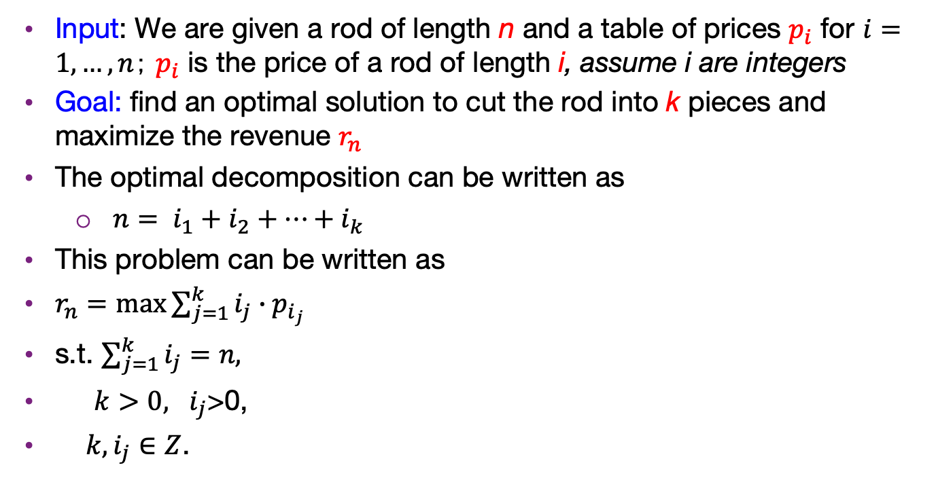
Rod cutting
Input: We are given a rod of length n and a table of prices $p_{i}$ for $i=1,…, n；$ $p_{i}$ is the price of a rod of length i, assume i are integers
Goal: find an optimal solution to cut the rod into k pieces and maximize the revenue $r_{n}$
The optimal decomposition can be written as
  $n= i_{1}+i_{2}+…+i_{k}$
This problem can be written as
$r_{n}=max{\sum_{j=1}^{k}{i_{j}∙p_{i_{j}}}}$
s.t. $\sum_{j=1}^{k}{i_{j}=n,}$
$k>0, i_{j}$>0,
$k, i_{j}∈Z$.

Slide 12
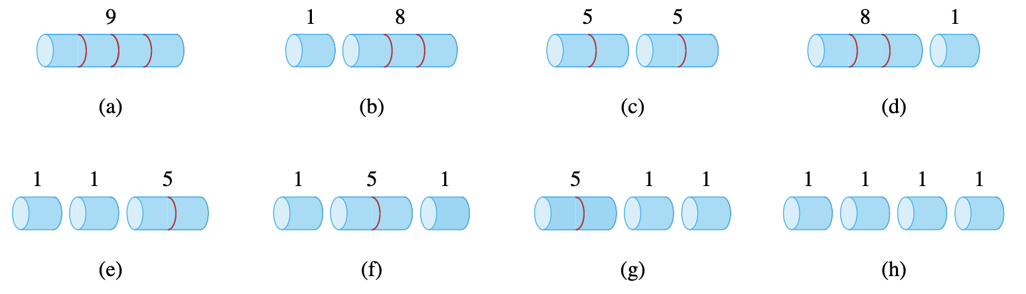
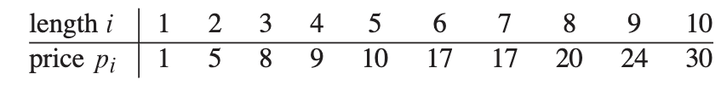
Rod cutting example
Different cutting gives different revenues

Slide 13
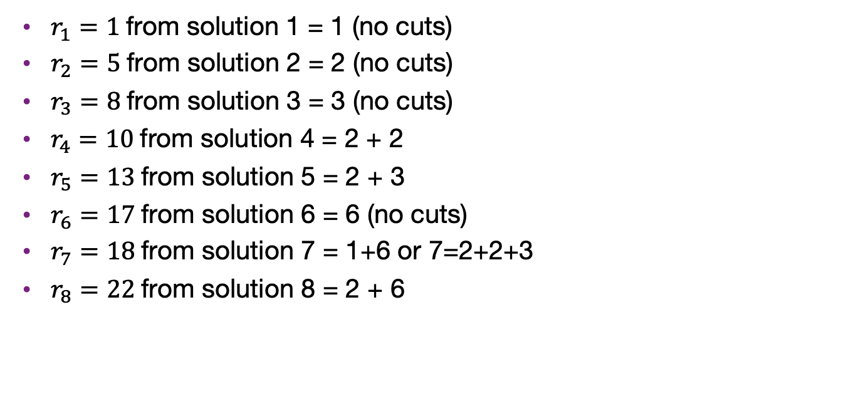
Rod cutting optimal revenues
$r_{1}=1$from solution 1 = 1 (no cuts)
$r_{2}=5$from solution 2 = 2 (no cuts)
$r_{3}=8$from solution 3 = 3 (no cuts)
$r_{4}=10$from solution 4 = 2 + 2
$r_{5}=13$from solution 5 = 2 + 3
$r_{6}=17$from solution 6 = 6 (no cuts)
$r_{7}=18$from solution 7 = 1+6 or 7=2+2+3
$r_{8}=22$from solution 8 = 2 + 6

Slide 14
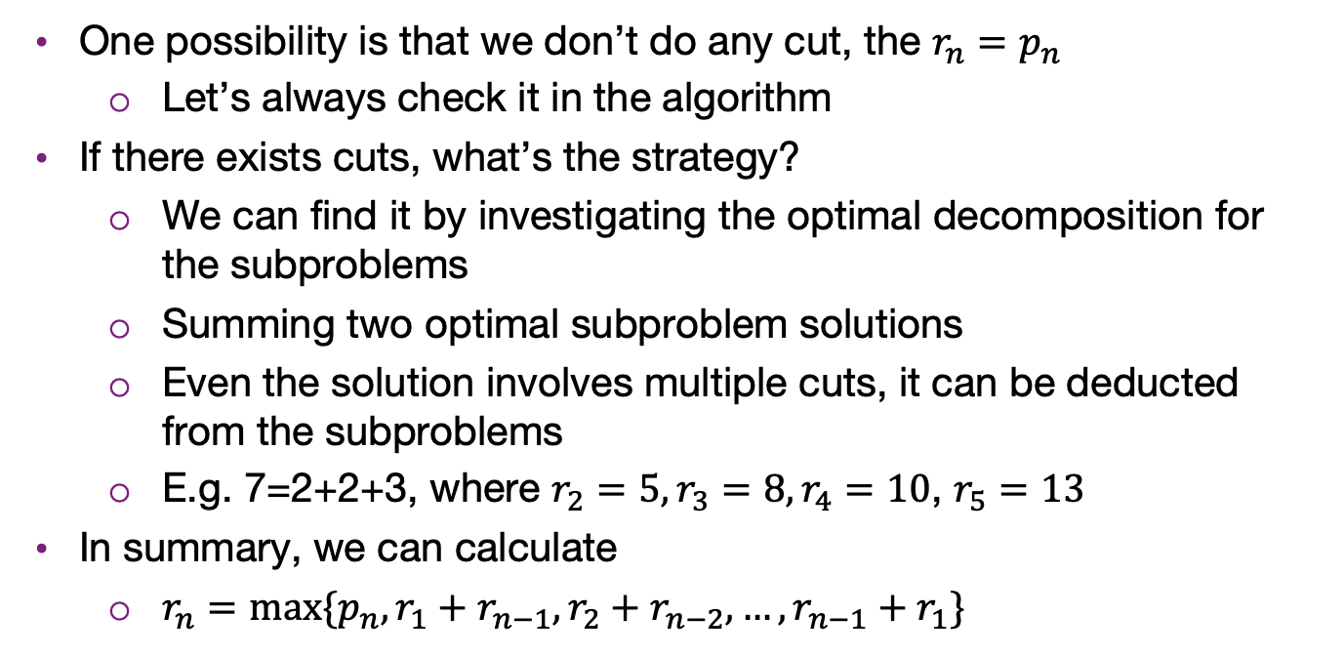
Strategy to find the optimal revenue
One possibility is that we don’t do any cut, the $r_{n}=p_{n}$
  Let’s always check it in the algorithm
If there exists cuts, what’s the strategy?
  We can find it by investigating the optimal decomposition for the subproblems
  Summing two optimal subproblem solutions
  Even the solution involves multiple cuts, it can be deducted from the subproblems
  E.g. 7=2+2+3, where $r_{2}=5,r_{3}=8,r_{4}=10$, $r_{5}=13$
In summary, we can calculate
  $r_{n}=max⁡\{p_{n}, r_{1}+r_{n−1}, r_{2}+r_{n−2},…, r_{n−1}+r_{1}\}$

Slide 15
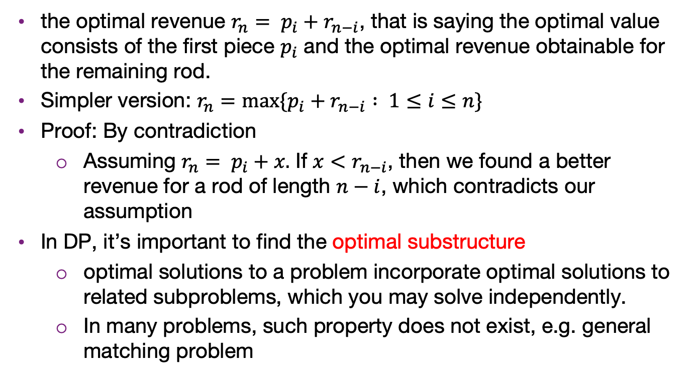
Optimal substructure for cutting rod problem
the optimal revenue $r_{n}= p_{i}+r_{n−i}$, that is saying the optimal value consists of the first piece $p_{i}$ and the optimal revenue obtainable for the remaining rod.
Simpler version: $r_{n}=max⁡\{p_{i}+r_{n−i} : 1≤i≤n\}$
Proof: By contradiction
  Assuming $r_{n}= p_{i}+x.$ If $x<r_{n−i}$, then we found a better revenue for a rod of length $n−i$, which contradicts our assumption
In DP, it’s important to find the optimal substructure
  optimal solutions to a problem incorporate optimal solutions to related subproblems, which you may solve independently.
  In many problems, such property does not exist, e.g. general matching problem

Slide 16
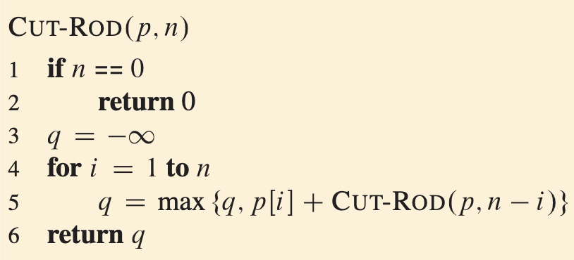

Recursively top-down implementation
With the recurrence function $r_{n}=max⁡\{p_{i}+r_{n−i} : 1≤i≤n\}$, we can implement an algorithm
Similar to the naive Fabonacci, we repeat the computations
$T\left(n\right)=1+\sum_{j=0}^{n−1}{T(j)→2^{n}}$
In practice, get the recurrence function is maybe the most difficult step.
You will be asked to derive the recurrence function in HWs

Slide 17
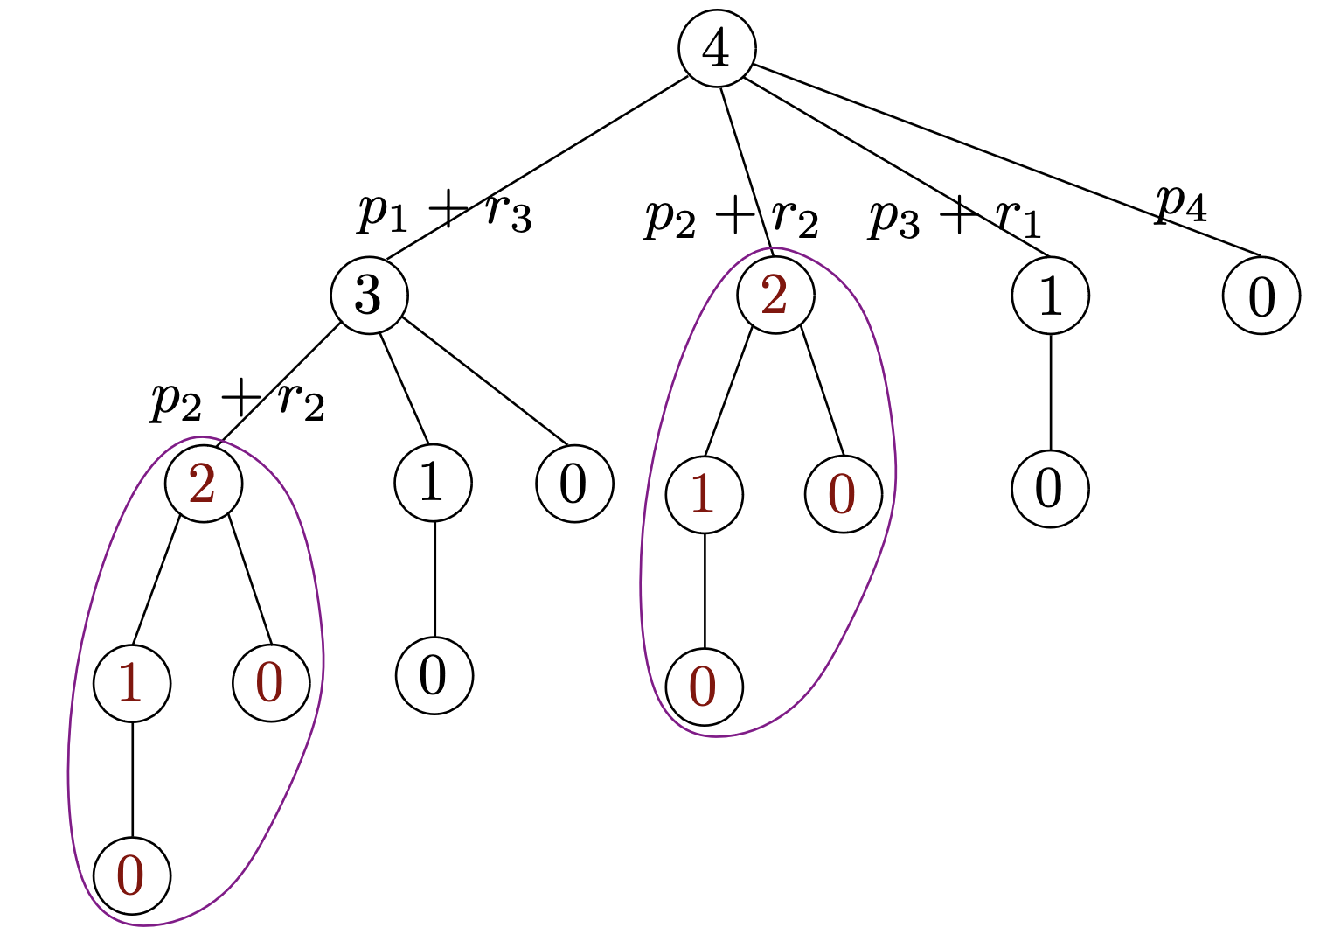
Explanation of exponential cost
Algorithm calls same subproblem many times

Slide 18
DP to record subproblem solutions
Two ways to record the subproblems
Top-down with memorization
  Still use the recursive function but “memorize” the subproblems
Bottom-up method
  Starts with the small subproblems first and move upward (like filling up a table)
They gives the same asymptotic runtime complexity
In practice, usually the bottom-up method is more efficient
  Top-down might skips some subproblems which seems to be efficient
  But recursive function call has runtime overhead, so the bottom-up way usually is faster

Slide 19
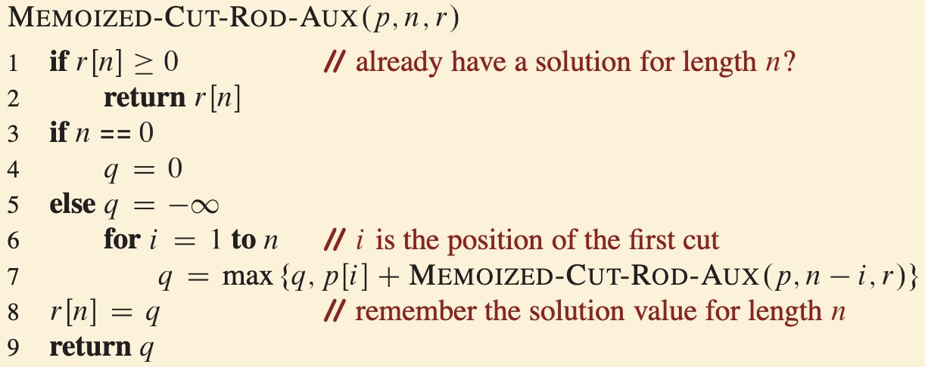
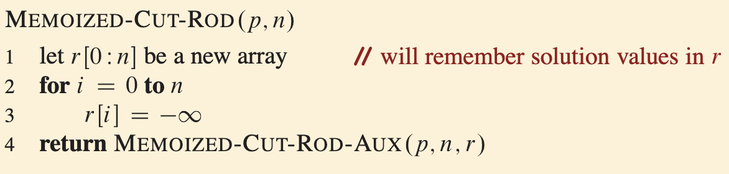
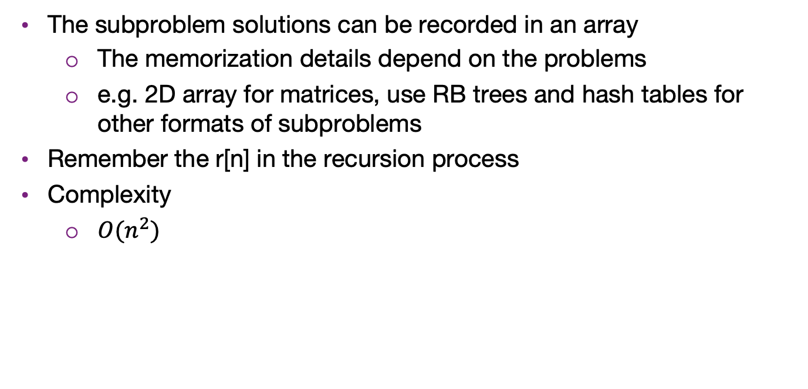
Top-down algorithm
The subproblem solutions can be recorded in an array
  The memorization details depend on the problems
  e.g. 2D array for matrices, use RB trees and hash tables for other formats of subproblems
Remember the r[n] in the recursion process
Complexity
  $O(n^{2})$

Slide 20
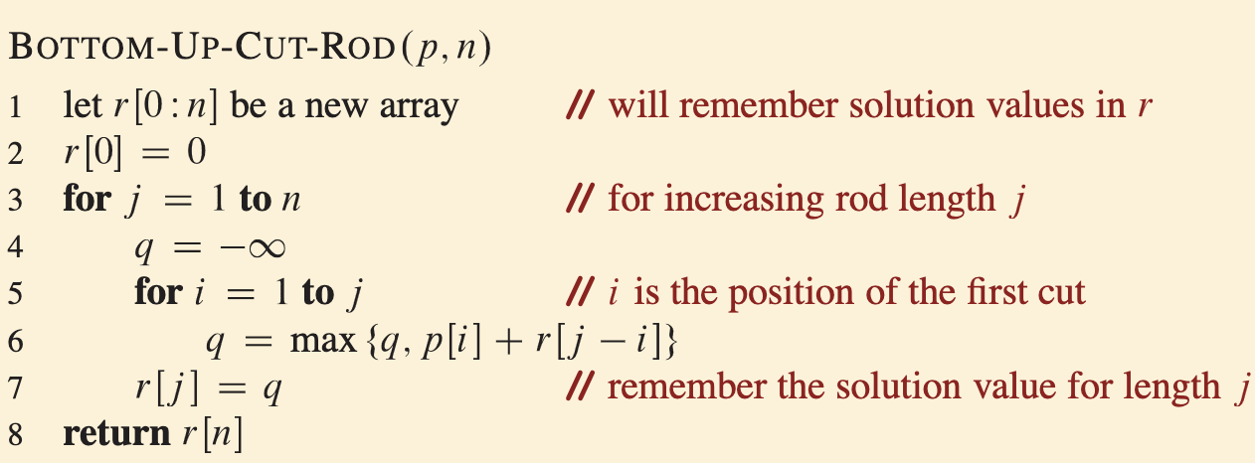

Bottom-up algorithm
Instead of recursion, we can build the subproblem array from bottom to top
  Filling the DP table
Complexity
  $O(n^{2})$
Done?

Slide 21
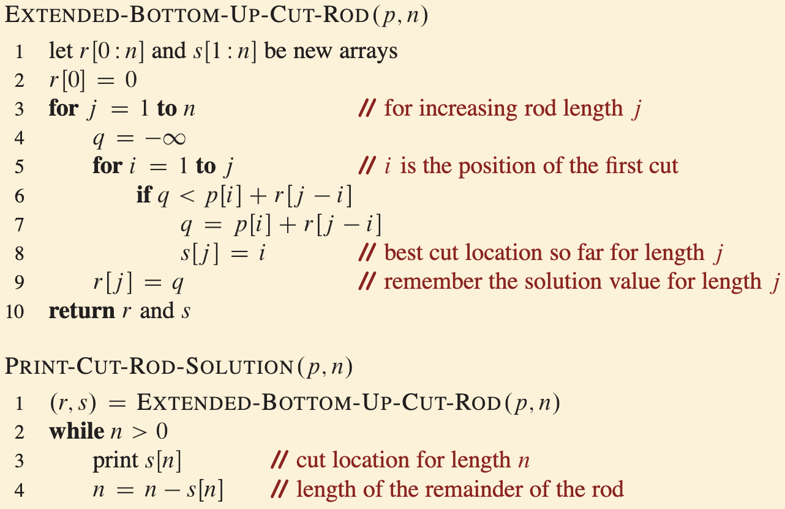
Reconstruct the solution
The previous algorithm can compute the optimal revenues
But we need to find the cutting corresponding to the revenues
  Backtrack the solutions and find where to make cuts

Slide 22
Recap the DP process
The basic steps to form a DP algorithm are
  1. Characterize the structure of an optimal solution
  2. Recursively define the value of an optimal solution
  3. Compute the value of an optimal solution, typically in a bottom-up fashion
  4. Construct an optimal solution from computed information
In practice, the format of the coding can be different
  Subproblem is not in regular array: multidimensional matrices, graphs, etc. We can touch on Bellman-Ford and Floyd-Warshall algorithms for shortest paths later if have time
  The algorithm is not always in polynomial time, e.g. knapsack problem

Slide 23
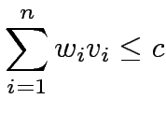
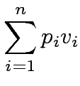
0/1 Knapsack Problem
We are given a knapsack of capacity c and a set of n objects numbered 1,2,…,n. Each object i has weight w_{i} and profit p_{i}.
Let v = [v₁, v₂,…, v_{n}] be a solution vector in which v_{i} = 0 if object i is not in the knapsack, and v_{i} = 1 if it is in the knapsack.
The goal is to find a subset of objects to put into the knapsack so that
(that is, the objects fit into the knapsack) and
is maximized (that is, the profit is maximized).

Slide 24
Knapsack Example
Item Number | Weight of Item | Value of Item | Value per unit Weight
1 | 1 | 6 | 6.0
2 | 2 | 11 | 5.5
3 | 4 | 1 | 0.25
4 | 4 | 12 | 3.0
5 | 6 | 19 | 3.167
6 | 7 | 12 | 1.714
Items:
Weight
Limit = 8
One greedy solution: Take the highest ratio item that will fit: (1, 6), (2, 11), and (4, 12)
Total value = 6 + 11 + 12 = 29
Is this optimal?

Slide 25
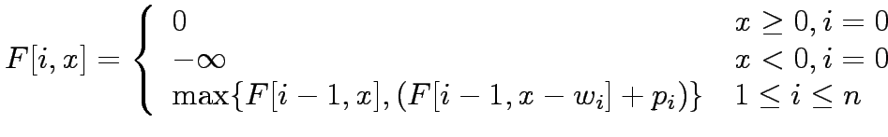
0/1 Knapsack Problem
The naive method is to consider all 2^{n} possible subsets of the n objects and choose the one that fits into the knapsack and maximizes the profit.
Let F[i,x] be the maximum profit for a knapsack of capacity x using only objects {1,2,…,i}. The DP formulation is:

Slide 26
Knapsack - Dynamic Programming
Recursive backtracking starts with max capacity and makes choice for items:
choices are:
  take the item if it fits
  don't take the item
Dynamic Programming, start with
simpler problems
Reduce number of items available
… AND Reduce weight limit on knapsack
Creates a 2d array of possibilities

Slide 27
Knapsack - Optimal Function
OptimalSolution(items, weight) is best solution given a subset of items and a weight limit
2 options:
OptimalSolution does not select i^{th} item
  select best solution for items 1 to i - 1with weight limit of w
OptimalSolution selects i^{th} item
  New weight limit = w - weight of i^{th} item
  select best solution for items 1 to i - 1with new weight limit

Slide 28
Knapsack Optimal Function
OptimalSolution(items, weight limit) =
0 if 0 items
OptimalSolution(items - 1, weight) if weight of ith item is greater than allowed weight
w_{i} > w (In others i^{th} item doesn't fit)
max of (OptimalSolution(items - 1, w),
value of i^{th} item +
OptimalSolution(items - 1, w - w_{i})

Slide 29
Knapsack - Algorithm
Create a 2d array to store
value of best option given
subset of items and
possible weights
In our example 0 to 6
items and weight limits of of 0 to 8
Fill in table using OptimalSolution Function
Item Number | Weight of Item | Value of Item
1 | 1 | 6
2 | 2 | 11
3 | 4 | 1
4 | 4 | 12
5 | 6 | 19
6 | 7 | 12

Slide 30
Knapsack - Table
Item | Weight | Value
1 | 1 | 6
2 | 2 | 11
3 | 4 | 1
4 | 4 | 12
5 | 6 | 19
6 | 7 | 12
items / capacity | 0 | 1 | 2 | 3 | 4 | 5 | 6 | 7 | 8
{} | 0 | 0 | 0 | 0 | 0 | 0 | 0 | 0 | 0
{1}
{1,2}
{1, 2, 3}
{1, 2, 3, 4}
{1, 2, 3, 4, 5}
{1, 2, 3, 4, 5, 6}

Slide 31
Knapsack - Table
Item | Weight | Value
1 | 1 | 6
2 | 2 | 11
3 | 4 | 1
4 | 4 | 12
5 | 6 | 19
6 | 7 | 12
items / capacity | 0 | 1 | 2 | 3 | 4 | 5 | 6 | 7 | 8
{} | 0 | 0 | 0 | 0 | 0 | 0 | 0 | 0 | 0
{1} | 0 | 6 | 6 | 6 | 6 | 6 | 6 | 6 | 6
{1,2} | 0 | 6 | ？
{1, 2, 3}
{1, 2, 3, 4}
{1, 2, 3, 4, 5}
{1, 2, 3, 4, 5, 6}

Slide 32
Knapsack - Table
Item | Weight | Value
1 | 1 | 6
2 | 2 | 11
3 | 4 | 1
4 | 4 | 12
5 | 6 | 19
6 | 7 | 12
max(6, 0+11)
items / capacity | 0 | 1 | 2 | 3 | 4 | 5 | 6 | 7 | 8
{} | 0 | 0 | 0 | 0 | 0 | 0 | 0 | 0 | 0
{1} | 0 | 6 | 6 | 6 | 6 | 6 | 6 | 6 | 6
{1,2} | 0 | 6 | ？
{1, 2, 3}
{1, 2, 3, 4}
{1, 2, 3, 4, 5}
{1, 2, 3, 4, 5, 6}

Slide 33
Knapsack - Completed Table
Item | Weight | Value
1 | 1 | 6
2 | 2 | 11
3 | 4 | 1
4 | 4 | 12
5 | 6 | 19
6 | 7 | 12
items / weight | 0 | 1 | 2 | 3 | 4 | 5 | 6 | 7 | 8
{} | 0 | 0 | 0 | 0 | 0 | 0 | 0 | 0 | 0
{1} [1, 6] | 0 | 6 | 6 | 6 | 6 | 6 | 6 | 6 | 6
{1,2} [2, 11] | 0 | 6 | 11 | 17 | 17 | 17 | 17 | 17 | 17
{1, 2, 3} [4, 1] | 0 | 6 | 11 | 17 | 17 | 17 | 17 | 18 | 18
{1, 2, 3, 4} [4, 12] | 0 | 6 | 11 | 17 | 17 | 18 | 23 | 29 | 29
{1, 2, 3, 4, 5} [6, 19] | 0 | 6 | 11 | 17 | 17 | 18 | 23 | 29 | 30
{1, 2, 3, 4, 5, 6} [7, 12] | 0 | 6 | 11 | 17 | 17 | 18 | 23 | 29 | 30

Slide 34
Knapsack - Items to Take
items / weight | 0 | 1 | 2 | 3 | 4 | 5 | 6 | 7 | 8
{} | 0 | 0 | 0 | 0 | 0 | 0 | 0 | 0 | 0
{1} [1, 6] | 0 | 6 | 6 | 6 | 6 | 6 | 6 | 6 | 6
{1,2} [2, 11] | 0 | 6 | 11 | 17 | 17 | 17 | 17 | 17 | 17
{1, 2, 3} [4, 1] | 0 | 6 | 11 | 17 | 17 | 17 | 17 | 17 | 17
{1, 2, 3, 4} [4, 12] | 0 | 6 | 11 | 17 | 17 | 18 | 23 | 29 | 29
{1, 2, 3, 4, 5} [6, 19] | 0 | 6 | 11 | 17 | 17 | 18 | 23 | 29 | 30
{1, 2, 3, 4, 5, 6} [7, 12] | 0 | 6 | 11 | 17 | 17 | 18 | 23 | 29 | 30

Slide 35
0/1 Knapsack Problem
Construct a table F of size n x c in row-major order.
Filling an entry in a row requires two entries from the previous row: one from the same column and one from the column offset by the weight of the object corresponding to the row.
Computing each entry takes constant time; the sequential run time of this algorithm is Θ(nc).
What does Θ(nc) mean?
  Similar to radix sort, it involves a constant
  From Lecture 3: size of n is the number of bits required to write out that input
  Value of c grows exponentially with the number of bits
  It is called pseudo-polynomial

Slide 36
Summary
DP is helpful when the optimal subproblems overlap
An optimal substructure is essential
  If dividing the problem introduce suboptimality, then DP may fail to produce optimal solution
Solving DP is usually using a bottom-up approach, where you fill up a DP table step by step
DP is useful in many scenarios, both in decision problems and optimization problems

Slide 37
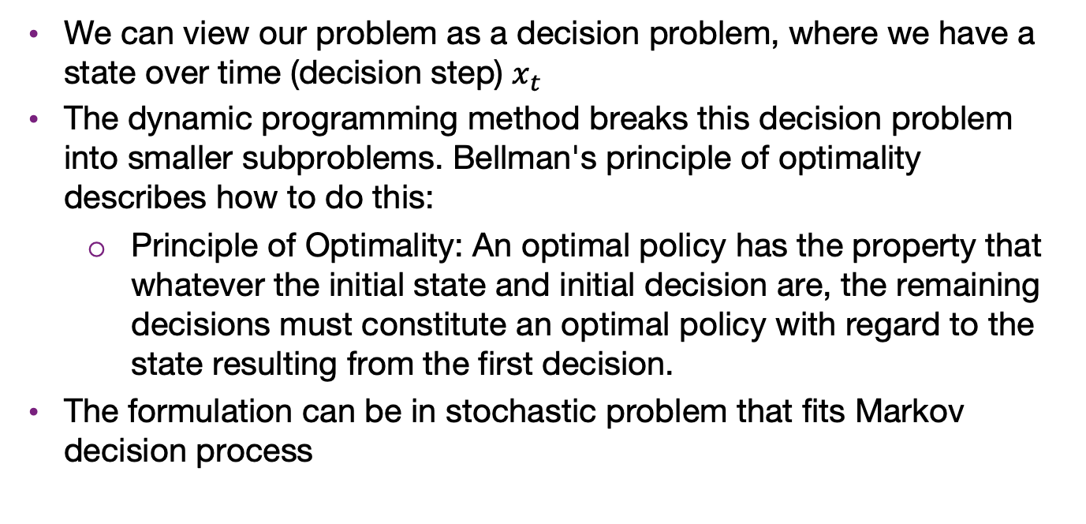
(Not in exam) Bellman's principle of optimality
We can view our problem as a decision problem, where we have a state over time (decision step) $x_{t}$
The dynamic programming method breaks this decision problem into smaller subproblems. Bellman's principle of optimality describes how to do this:
  Principle of Optimality: An optimal policy has the property that whatever the initial state and initial decision are, the remaining decisions must constitute an optimal policy with regard to the state resulting from the first decision.
The formulation can be in stochastic problem that fits Markov decision process

